Slide 1


Regional frequency analysis of hydro-meteorological extremes Non-standard aspects
Dhouha Ouali, Ph.D.
Research associate, MEOPAR-PCIC
Oct. 25th 2017

Slide 2
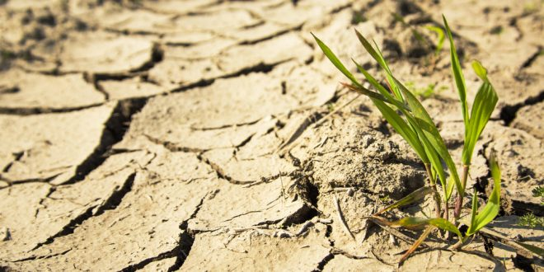
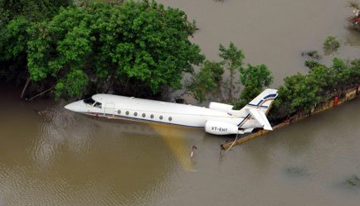
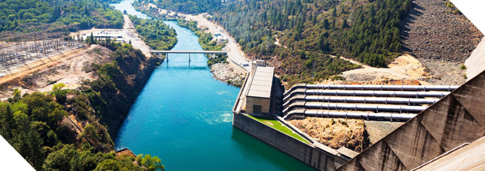
Introduction…
Flood risk
Drought risk
Risk Assessment
water resource management

Slide 3
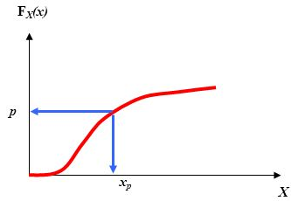
Frequency Analysis
General scheme
Extract a sample of extreme values from the discharges series
Fit an adequate statistical distribution
Estimate parameters
Compute quantities of interest (quantiles)
Discharge(m³/s)

Slide 4
Frequency Analysis
Available data series are too short
Unavailable data series
Consequences:
Large uncertainties
No estimates of flood design
Using data from different sites can reduce the uncertainties and provide estimates at ungauged sites

Slide 5
Regional Frequency analysis (RFA)
Basic principles
Each gauged site:
X: Physio-meteorological variables
Y: Hydrological variables
Gauged sites
Ungauged site

Slide 6
Regional Frequency analysis (RFA)
1. At-site frequency Analysis
Each gauged site:
X: Physio-meteorological variables
Y: Hydrological variables hydrologiques
Quantile estimate at gauged sites
Gauged sites
Ungauged site

Slide 7
Regional Frequency analysis (RFA)
Transfer of the hydrological information from gauged sites to the ungauged site
Gauged sites
Ungauged site

Slide 8
Regional Frequency analysis (RFA)
2. Delineation of Homogeneous Regions
Homogeneous region: similar physiographic and meteorological attributes to the target site
Gauged sites
Ungauged site

Slide 9
Regional Frequency analysis (RFA)
3. Regional Estimation
Transfer of the hydrological information from gauged sites to the ungauged site within a homogeneous region
Gauged sites
Ungauged site

Slide 10
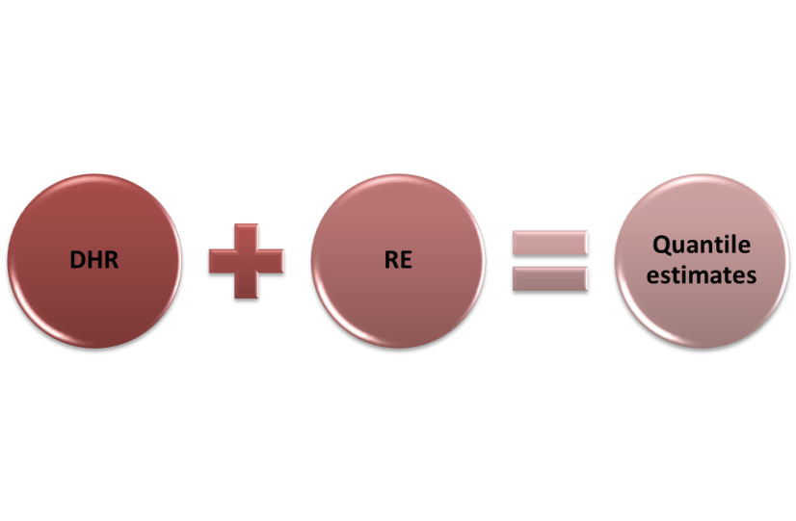

Problems definition
Nonlinear modeling of the hydrological processes
DHR
Not exploited
RE
Inconsistency
Non linear Methodes
Linear Methodes

Slide 11
Problems definition
B. Exploitation of the hydrological information
Ignore sites with short data sets
?
Long data series
?
Short data seris
Ungauged site
11

Slide 12







Proposed methodologies
Linear approaches in DHR
Canonical Correlation Analysis (CCA)
U=a X
Maximize
Linear Relationships
V = b Y
$${\hat{S}}_{0}$$
$$U_{1}$$
$$S_{0}$$
$$V_{1}$$
$$U_{2}$$
$$V_{2}$$
Homogeneous Region of
$${\hat{S}}_{0}$$

Slide 13
Proposed methodologies
Linear approaches in DHR
Canonical Correlation Analysis (CCA)
Regionalization methods (DHR)
RFA Model
RE methods
CCA-MLR
MLR
CCA

Slide 14
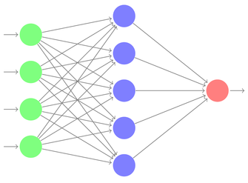


Proposed methodologies
1.Non-linear approaches in DHR
Non-linear Canonical Correlation Analysis (NLCCA)
Input Layer
Hidden Layers
Output Layer
Non-linear canonical space
$$U$$
$$V$$
$${\hat{S}}_{0}$$
$$U_{1}$$
$$S_{0}$$
$$V_{1}$$
$$U_{2}$$
$$V_{2}$$
Homogeneous Region of
$${\hat{S}}_{0}$$

Slide 15
Proposed methodologies
1.Non-linear approaches in DHR
Regionalization methods (DHR)
RFA Model
RE methods
CCA-MLR
MLR
CCA
NLCCA-MLR
NLCCA

Slide 16
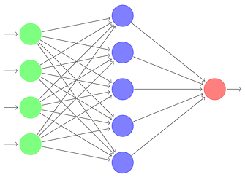
Proposed methodologies
2.Non-linear approaches in RE
Regionalization methods (DHR)
RFA Model
RE methods
CCA-MLR
MLR
CCA
NLCCA-MLR
ANN
CCA-ANN
NLCCA
NLCCA-ANN
Single Artificial Neural Network (ANN)

Slide 17
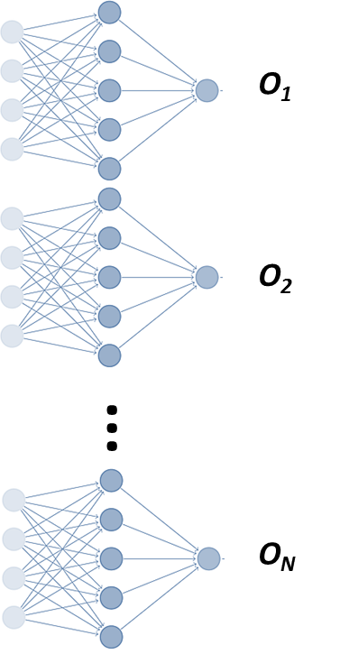
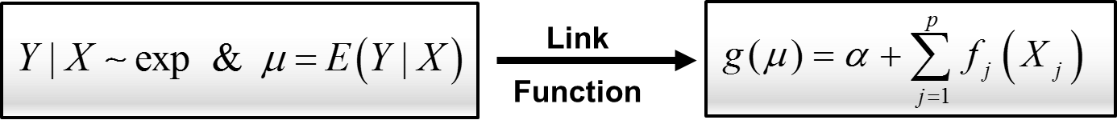
Proposed methodologies
Regionalization methods (DHR)
RFA Model
RE methods
CCA-MLR
MLR
CCA
NLCCA-MLR
ANN
CCA-ANN
NLCCA
NLCCA-ANN
EANN
CCA-EANN
GAM
NLCCA-EANN
Ensemble Artificial Neural Network (EANN)
CCA-GAM
NLCCA-GAM
Generalized Additive Models (GAM)

Slide 18
Proposed methodologies
Regionalization methods (DHR)
RFA Model
RE methods
Linear
CCA-MLR
MLR
CCA
NLCCA-MLR
ANN
CCA-ANN
NLCCA
NLCCA-ANN
EANN
CCA-EANN
GAM
NLCCA-EANN
CCA-GAM
NLCCA-GAM

Slide 19
Proposed methodologies
Regionalization methods (DHR)
RFA Model
RE methods
Linear
CCA-MLR
MLR
CCA
NLCCA-MLR
ANN
CCA-ANN
NLCCA
NLCCA-ANN
EANN
CCA-EANN
Semi-Linear
GAM
NLCCA-EANN
CCA-GAM
NLCCA-GAM

Slide 20
Proposed methodologies
Regionalization methods (DHR)
RFA Model
RE methods
Linear
CCA-MLR
MLR
CCA
NLCCA-MLR
ANN
CCA-ANN
NLCCA
NLCCA-ANN
EANN
CCA-EANN
Semi-Linear
GAM
NLCCA-EANN
Non-Linear
CCA-GAM
NLCCA-GAM

Slide 21
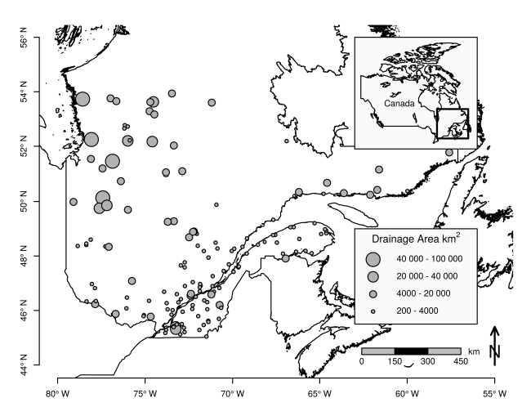
Data
Southern Quebec, Canada;
151 hydrometric stations;
5 physio-meteorological variables
3 hydrological variables: QS10, QS50 and QS100;
Annual maximum discharge :
1900 - 2002

Slide 22
Results
Nonlinear modeling of the hydrological processes
Leave-one-out cross-validation procedure
For k=1…N sites
Remove temporary the k^{th} site from the dataset, ungauged site
Train the RFA model using the remaining sites
Compare regional and at-site estimated quantiles (RMSE, BIAS)

Slide 23
Results
Nonlinear modeling of the hydrological processes
CCA-MLR
CCA-ANN
CCA-EANN
CCA-GAM
NLCCA-MLR
NLCCA-ANN
NLCCA-EANN
NLCCA-GAM

Slide 24
Results
Nonlinear modeling of the hydrological processes
CCA-MLR
NLCCA-MLR
Regional Quantile (m³/s.km²)
NLCCA-GAM
At-site Quantile (m³/s.km²)

Slide 25
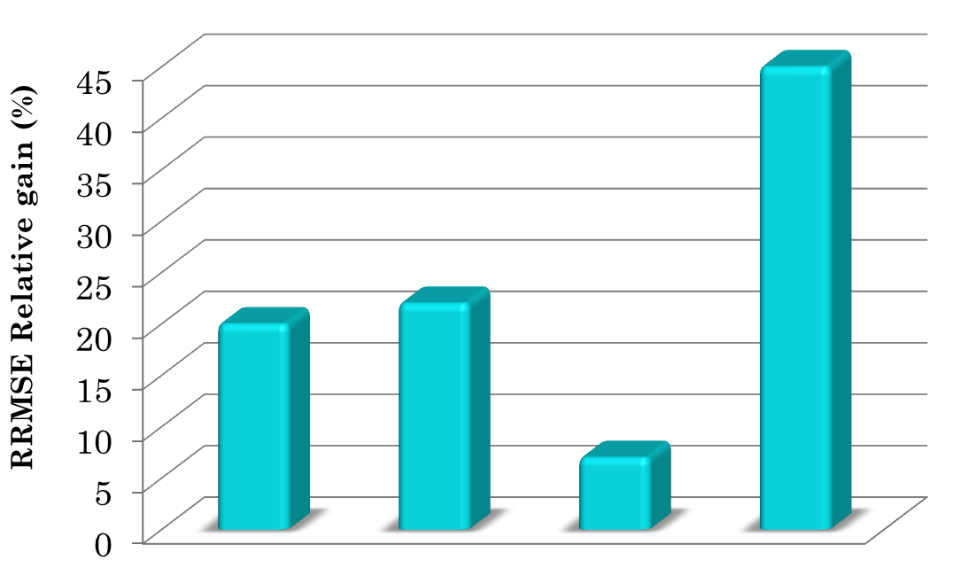
Results
Nonlinear modeling of the hydrological processes
Relatif Gain of RRMSE compared to the CCA-MLR model, Qs100
NL/NL
L/NL
Relatif Gain of RRMSE (%)
NL/L
L/NL
NLCCA-MLR
CCA-GAM
CCA-ANN
NLCCA-GAM

Slide 26
B. Exploitation of the hydrological information

Slide 27





Proposed methodologies
B. Exploitation of the hydrological information
Data
Y : hydrological Variables
Traditional Approach
Y ; n≥n_{c}
Y; n<n_{c}
n_{c} : Record length threshold
$$S_{1}$$
$$S_{2}$$
$$⋮$$
$$S_{n′}$$
FA
$$q_{1}^{L}$$
At-site estimated quantiles
Multiple Linear Regression(MLR)
FA
$$q_{2}^{L}$$
Regional estimated Quantiles
$$⋮$$
FA
$$q_{n′}^{L}$$
X : physiographic Variables
n>nc

Slide 28

Proposed methodologies
B. Exploitation of the hydrological information
Data
Y : hydrological Variables
Traditional Approach
Y ; n≥n_{c}
Y; n<n_{c}
n_{c} : Record length threshold
$$S_{1}$$
$$S_{2}$$
$$⋮$$
$$S_{n′}$$
FA
$$q_{1}^{L}$$
At-site estimated quantiles
Multiple Linear Regression(MLR)
FA
$$q_{2}^{L}$$
Regional estimated Quantiles
$$⋮$$
FA
$$q_{n′}^{L}$$
X : physiographic Variables
n>nc

Slide 29
Proposed methodologies
B. Exploitation of the hydrological information
Data
Y : hydrological Variables
Traditional Approach
Y ; n≥n_{c}
Y; n<n_{c}
n_{c} : Record length threshold
$$S_{1}$$
$$S_{2}$$
$$⋮$$
$$S_{n′}$$
FA
$$q_{1}^{L}$$
At-site estimated quantiles
Multiple Linear Regression(MLR)
FA
$$q_{2}^{L}$$
Regional estimated Quantiles
$$⋮$$
FA
$$q_{n′}^{L}$$
X : physiographic Variables
n>nc

Slide 30
Proposed methodologies
B. Exploitation of the hydrological information
Data
Y : hydrological Variables
Traditional Approach
Y ; n≥n_{c}
Y; n<n_{c}
n_{c} : Record length threshold
$$S_{1}$$
$$S_{2}$$
$$⋮$$
$$S_{n′}$$
FA
$$q_{1}^{L}$$
At-site estimated quantiles
Multiple Linear Regression(MLR)
FA
$$q_{2}^{L}$$
Regional estimated Quantiles
$$⋮$$
FA
$$q_{n′}^{L}$$
X : physiographic Variables
n>nc

Slide 31
Proposed methodologies
B. Exploitation of the hydrological information
Data
Y : hydrological Variables
Y : hydrological Variables
Y ; n≥n_{c}
Y; n<n_{c}
n_{c} : Record length threshold
All sites
Quantile Regression(QR)
Regional estimated Quantiles
X : physiographic Variables
n>nc

Slide 32
Proposed methodologies
Evaluation
RMSE
Unquantified error
RMSE
Regional Quantile
True quantile
At-site Quantile
At-site Quantile
reference
Short data series
Long data series

Slide 33
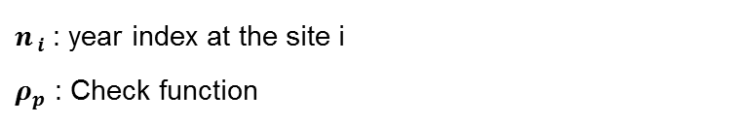
Proposed methodologies
Evaluation
Proposed criterion: Mean Piecewise loss function
n : Total number of observations at all sites
N : Number of sites
$n_{ i}$ : year index at the site i
$ρ_{p}$ : Check function

Slide 34

Results
B. Exploitation of the hydrological information
Q_{S100}
MLR
QR
Regional Quantile (m³/s.km²)
At-site Quantile (m³/s.km²)
Record length

Slide 35
Results
B. Exploitation of the hydrological information
 | Q_{S10} |  | Q_{S50} |  | Q_{S100}
 | MLR | QR | MLR | QR | MLR | QR
MPLF (m³/s.km²) | 16.07 | 15.43 | 6.62 | 5.30 | 4.65 | 3.43
MPLF: Mean Piecewise loss function

Slide 36
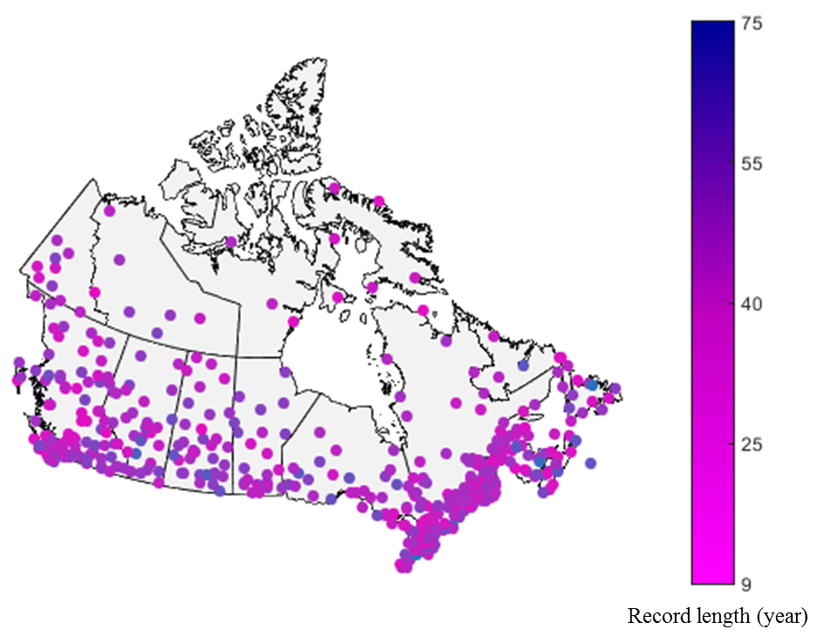
Regional IDF curves
The occurrence frequency of a rainfall event of given intensity and duration is important to establish a measure of risk.
Estimating Intensity-Duration-Frequency Curves at ungauged sites
Data:
Annual rainfall maxima (ECCC)
564 stations, Canada, 1905 - 2013
Durations: 5, 10, 15, 30-min and 1, 2,
6, 12, 24-h
Longitude, latitude, elevation, aspect,
slope and surface roughness

Slide 37
Regional IDF curves
Rainfall and physiographical data
RFA approaches
Index storm approach
Regressive approaches
Extremes of short and long storm durations
ROI-CCA-NLCCA
CCA-NLCCA
DHR
Regional Gumbel
QR and QRNN
RE
Rainfall intensities for all durations and return periods (2,5,10,50 and 100 years)

Slide 38
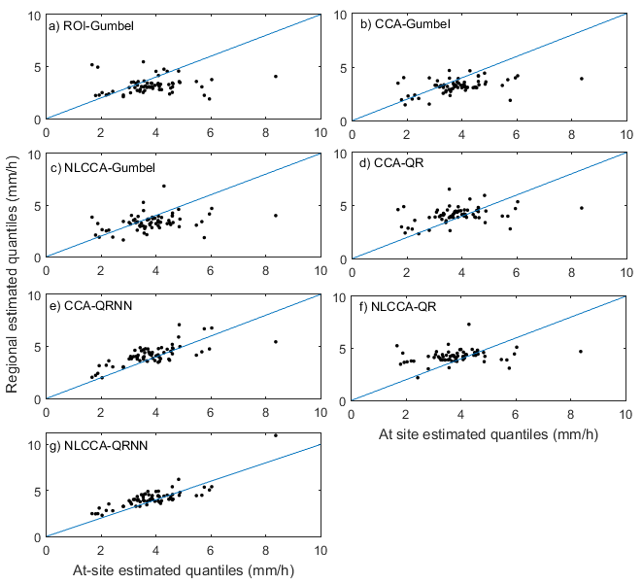
Results - Regional IDF curves
At-site and regional estimated 50-years return period (quantile 0.98) for the 24h storm duration

Slide 39
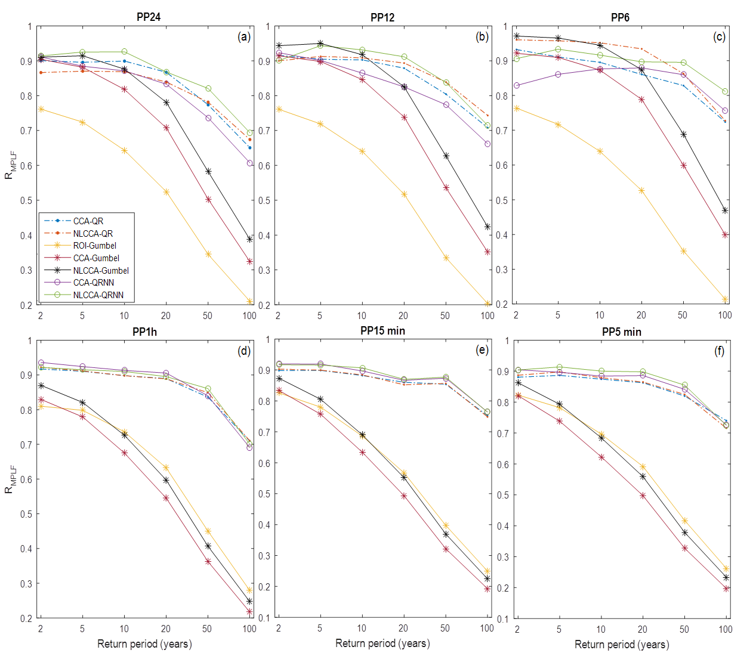
Results - Regional IDF curves

Slide 40
Conclusions
Considering Non-linearity in the two RFA steps leads to better results than linear cases;
Considering a non-linear component at the first step (DHR) or at the second step (RE) of the RFA process leads to similar results;
A direct RFA approach based on QR is a promising method for the estimation and evaluation of flood quantiles at-sites with short to medium record lengths;
A QR-based approach (under linear and non linear versions) provides better estimates of IDF curves at ungauged sites as compared to the commonly used approach, the index storm.

Slide 41
Publications
1. D. Ouali, F. Chebana et T.B.M.J. Ouarda (2016a). "Non-linear canonical correlation analysis in regional frequency analysis". Stoch Environ Res Risk Assess. DOI 10.1007/s00477-015-1092-7.
2. D. Ouali, F. Chebana et T.B.M.J. Ouarda (2017). "Fully nonlinear regional hydrological frequency analysis". Journal of Advances in Modeling Earth Systems, 9(2), 1292-1306.
3. D. Ouali, F. Chebana et T.B.M.J. Ouarda (2016b). "Quantile regression in regional frequency analysis: a better exploitation of the available information". Journal of Hydrometeorology. DOI: 10.1175/JHM-D-15-0187.1
4. D. Ouali, A.J. Cannon. "Estimation of rainfall Intensity–Duration–Frequency curves at ungauged locations using quantile regression methods". Submitted.

Slide 42

Thank you ...!

